Slide 1
Malignant URL Finder
Presented by :
Deepak Garg
Vipul Garg
Manshiv Kathait
Group : 13E
Mentored by : Ashish Khanna
Notes:
<number>

Slide 2
Motivation
Web services drive new opportunities for people to interact, they also create new opportunities for criminals
Google detects about 300,000 malicious websites per month, this is a clear indication that these opportunities are being used by criminals
Almost all online threats have something in common, they all require the user to click on a hyperlink or type in a website address

Slide 3
Motivation
The user needs to perform sanity checks and assessing the risk of visiting a URL
Performing such an evaluation might be impossible for a novice user
As a result, users often end up clicking links without paying close attention to the URLs – this further makes them vulnerable to malicious websites on the web which in turn exploit them

Slide 4
Introduction
Openness of the web exposes opportunities for criminals to upload malicious content
Do techniques exist to prevent malicious content from entering the web?

Slide 5
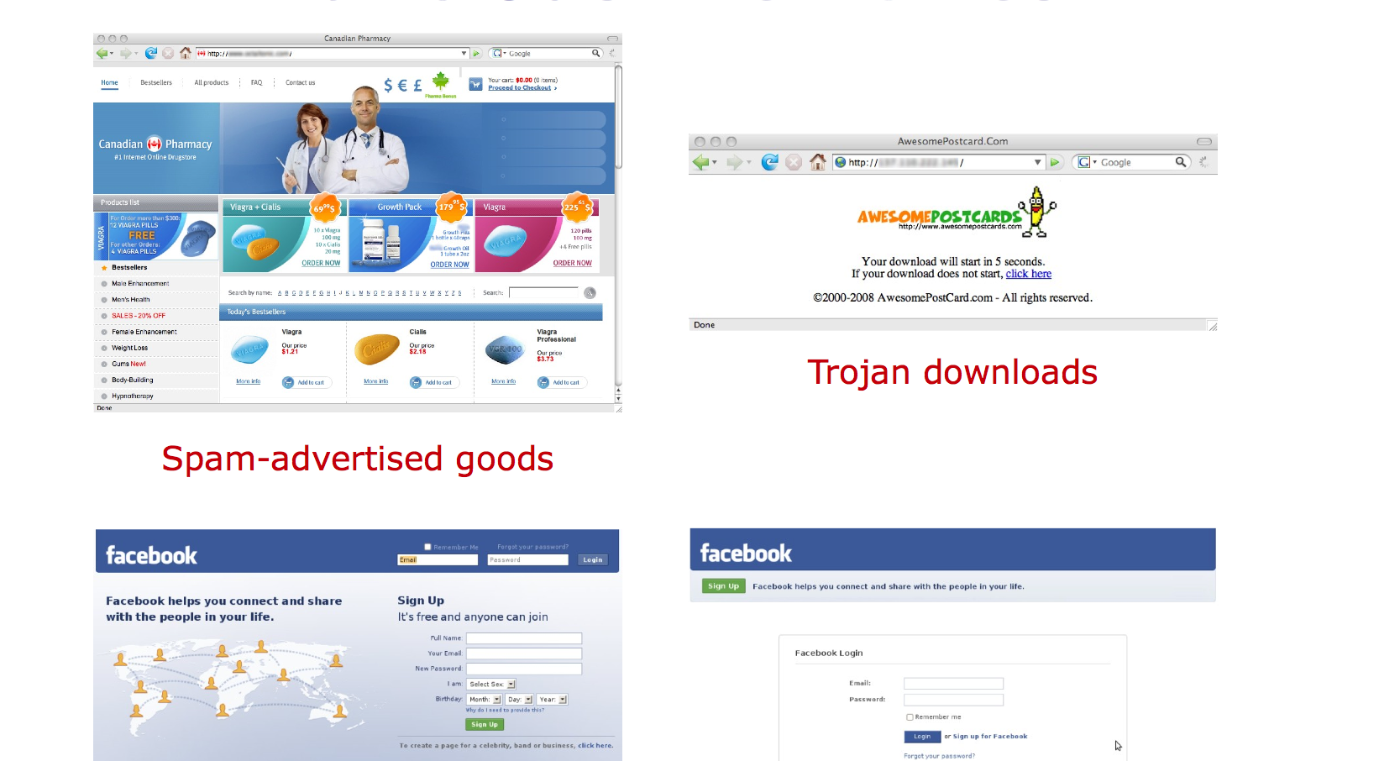
Malicious websites
Phishing : which one is real ??

Slide 6
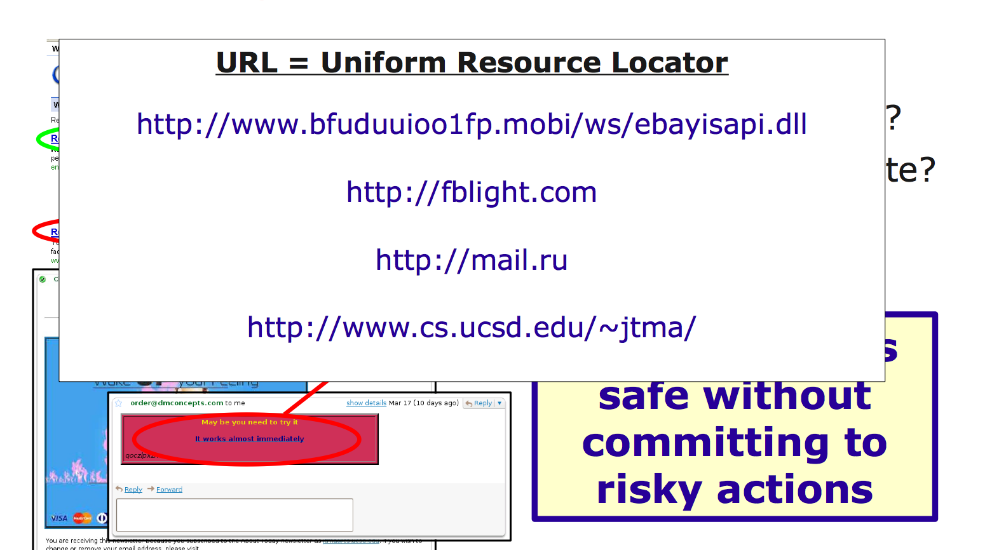
Visiting Malicious Websites

Slide 7
Current Techniques
Security practitioners have developed techniques such as blacklisting in order to protect users from malicious websites
Although this approach has minimal overhead, it does not provide complete protection as about only 55% of the malicious URLs are present in blacklists
Another drawback of this approach is that malicious websites are not a part of the blacklist during the period before their detection

Slide 8
Current Techniques
Security researchers have done extensive research in order to detect accounts on social networks that are used for spreading messages that are malicious
The approach still does not provide thorough protection for users in areas such as social networks where the interaction is in real-time because there is a need to build a profile of malicious activity and the process can take a considerable amount of time

Slide 9
Overview of Features
Lexical features
These features have values of both types-binary and continuous
These features include
Length of the URL
Number of dots in the URL
Tokens present in the hostname, primary domain, and path parts of a URL
Features in the hostname are further characterized as bigrams
Bigrams are able to capture a certain pattern on character strings permuted randomly and occurring in certain combinations
Example: www.depts.ttu.edu → Bigrams: depts ttu, ttu edu

Slide 10
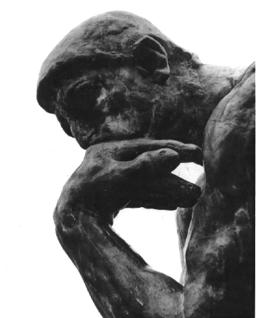

Lexical Features
Tokens in URL hostname + path
Length of URL
Entropy of the domain name
http://www.bfuduuioo1fp.mobi/ws/ebayisapi.dll
Notes:
<number>

Slide 11
Overview of Features
Host-Based features
IP address of the URL – A Record
IP address of the Mail Exchanger – MX Record
IP address of the Name Server – NS Record
PTR Record
AS number
IP Prefix

Slide 12

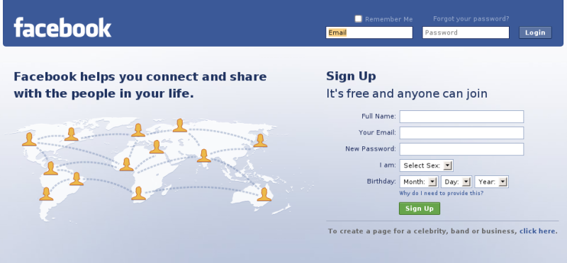
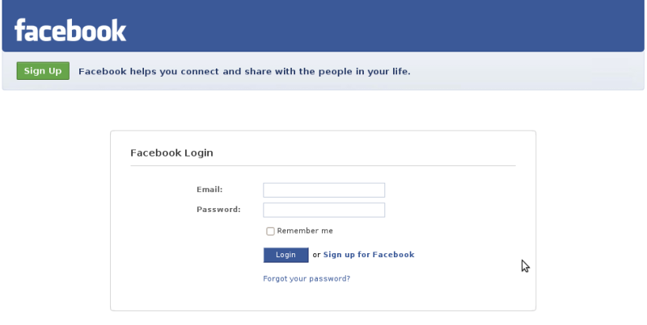

Host-Based Features
Blacklisted? (SORBS, URIBL, SURBL, Spamhaus)
WHOIS: registrar, registrant, dates
IP address: Which ASes/IP prefixes?
DNS: TTL? PTR record exists/resolves?
Geography-related: Locale? Connection speed?
facebook.com
fblight.com
69.63.176.0/20
75.102.60.0/22
Notes:
<number>

Slide 13
Overview of Features
Malicious websites have exhibited a pattern of being hosted in a particular “bad” portion of the Internet
Example: McColo provided hosting for major botnets, which in turn were responsible for sending 41% of the world’s spam just before McColo’s takedown in November 2008. McColo’s AS number was 26780
These portions of the internet can be characterized on a regular basis by retraining on the predictor variables
This allows keeping track of concept drift

Slide 14
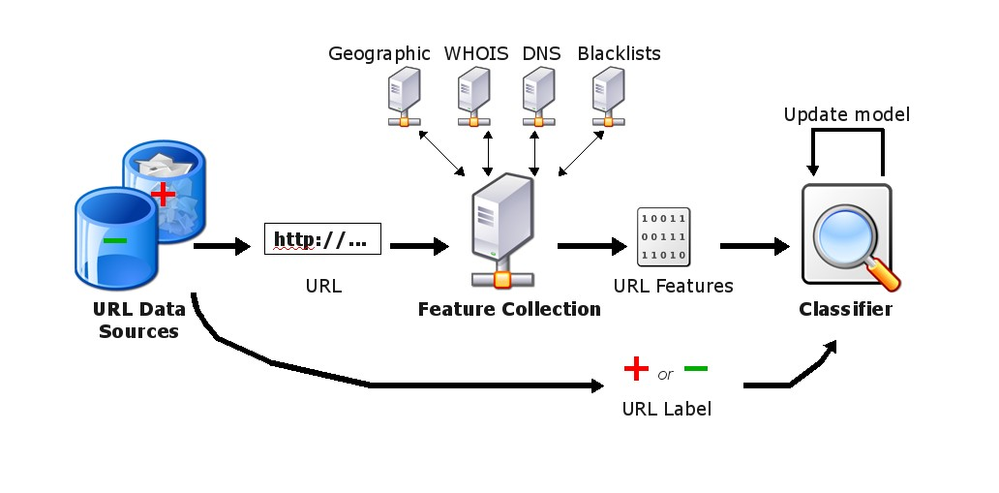




URL Classification System
Label
Example
Hypothesis
Notes:
<number>

Slide 15
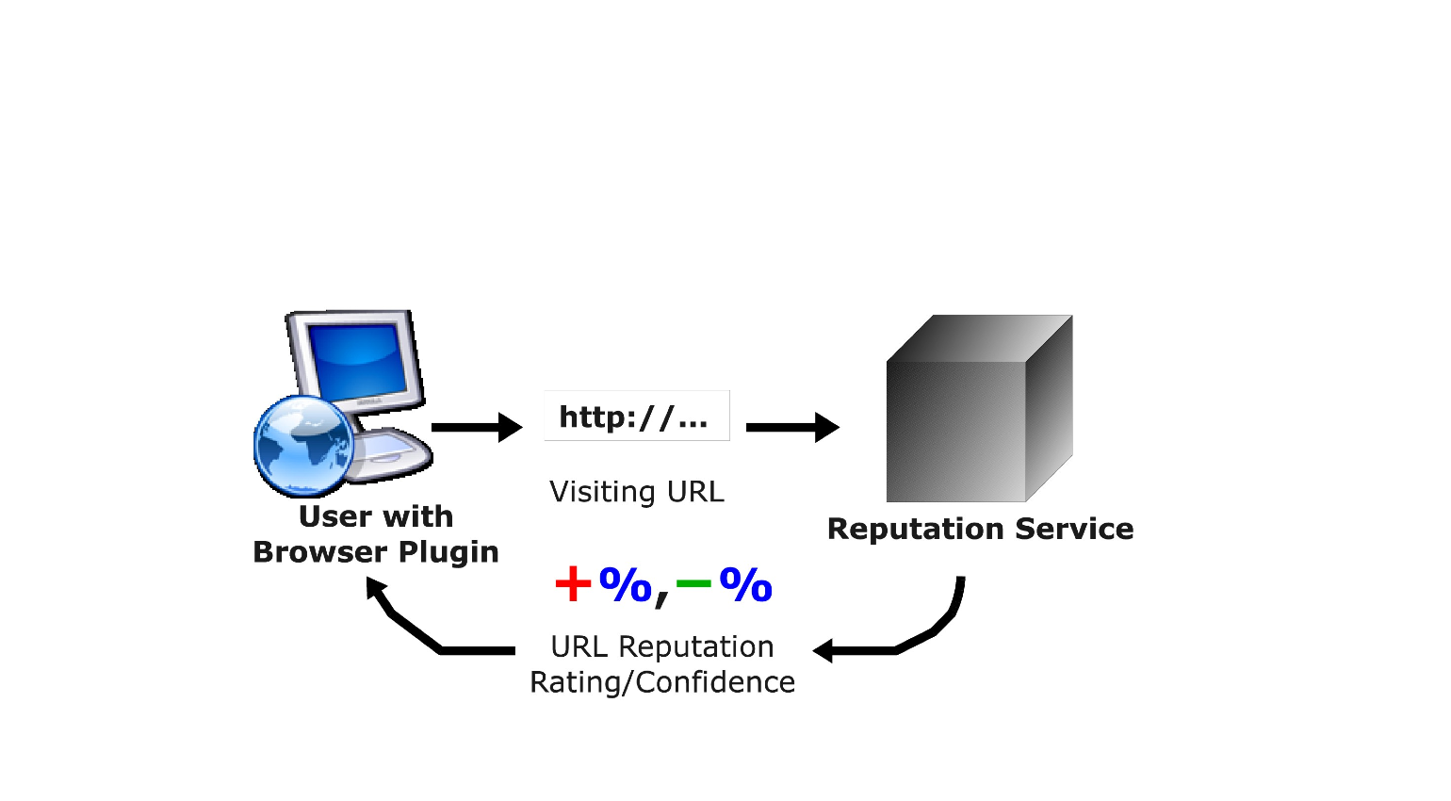
What we want ?

Slide 16
Problem in a Nutshell
<number>
URL features to identify malicious Web sites
No context, no content
Different classes of URLs
Benign, spam, phishing, exploits, scams...
For now, distinguish benign vs. malicious
facebook.com
fblight.com
Notes:
<number>

Slide 17
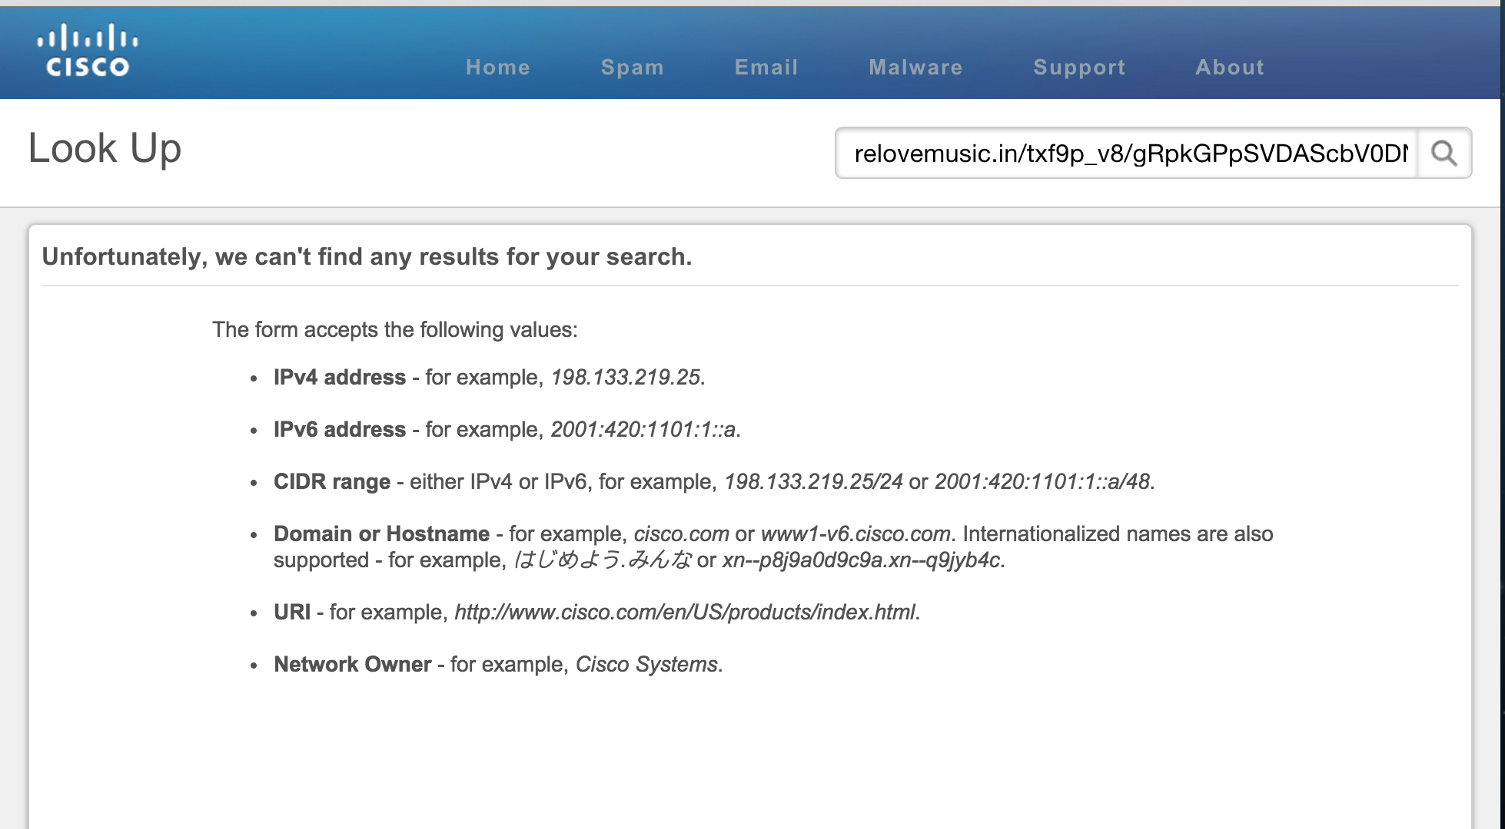
Information about new websites

Slide 18

State of the Practice
Current approaches
Blacklists [SORBS, URIBL, SURBL, Spamhaus]
Learning on hand-tuned features [Garera et al, 2007]
Limitations
Cannot predict unlisted sites
Cannot account for new features
Arms race: Fast feedback cycle is critical
More automated approach?
Notes:
<number>

Slide 19
Data Sets
Malicious URLs
5,000 from PhishTank (phishing)
15,000 from Spamscatter (spam, phishing, etc)
Benign URLs
15,000 from Yahoo Web directory
15,000 from DMOZ directory
Malicious x Benign → 4 Data Sets
30,000 – 55,000 features per data set
Notes:
<number>

Slide 20
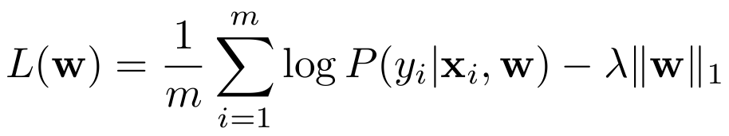
Algorithms
Logistic regression w/ L1-norm regularization
Implicit feature selection
Easier to interpret
Other models
Naive Bayes
Support vector machines (linear, RBF kernels)
Notes:
<number>

Slide 21
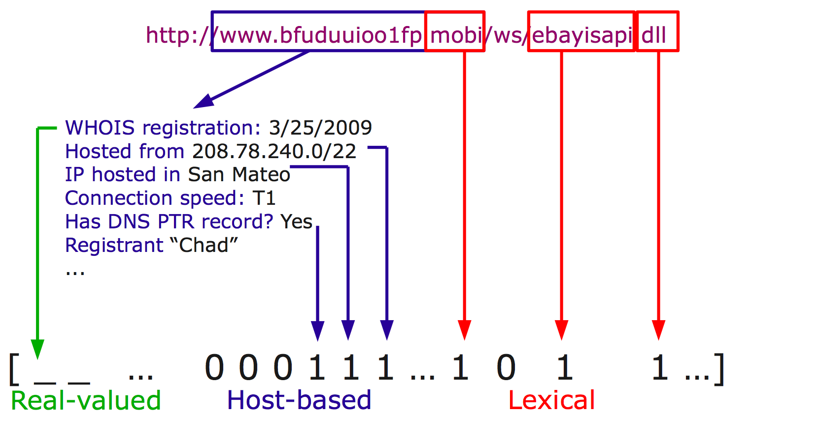
Feature vector construction

Slide 22
Today's Focus
Example
Notes:
<number>

Slide 23





Features to consider?
Blacklists
Simple heuristics
Domain name registration
Host properties
Lexical
Notes:
<number>

Slide 24
(1) Blacklist Queries
List of known malicious sites
Providers: SORBS, URIBL, SURBL, Spamhaus
Blacklist queries as features
In blacklist?
In blacklist?
http://www.bfuduuioo1fp.mobi
Yes
http://www.bfuduuioo1fp.mobi
........................................
........................................
http://fblight.com
No
Notes:
<number>

Slide 25
(2) Manually-Selected Features
Considered by previous studies
IP address in hostname?
Number of dots in URL
WHOIS (domain name) registration date
http://72.23.5.122/www.bankofamerica.com/
http://www.bankofamerica.com.qytrpbcw.stopgap.cn/
stopgap.cn registered 28 June 2009
Notes:
<number>

Slide 26

(3) WHOIS Features
Domain name registration
Date of registration, update, expiration
Registrant: Who registered domain?
Registrar: Who manages registration?
http://yammeringyellowtail.com
http://angryalbacore.com
Registered on
29 June 2009
By SpamMedia
http://sleazysalmon.com
http://mangymackerel.com
Notes:
<number>

Slide 27
Which feature sets?
# Features
Blacklist
3
Manual
4
WHOIS
4,000
Host-based
13,000
Lexical
17,000
Full
30,000
w/o WHOIS/Blacklist
26,000
Notes:
<number>

Slide 28
Beyond Blacklists
Yahoo-PhishTank
Full features
Blacklist
Higher detection rate for given false positive rate
Notes:
<number>

Slide 29
Limitations
False positives
Sites hosted in disreputable ISP
Guilt by association
False negatives
Compromised sites
Free hosting sites
Hosted in reputable ISP
Notes:
<number>

Slide 30
Conclusion
Detect malicious URLs with high accuracy
Only using URL
Diverse feature set helps: 86.5% w/ 18,000+ features
Proof concept working in lab
Future work
Assessing malicious content on website.
Assessing JavaScript code for malware detection.
Detection of downloaded malware using DNS information
Notes:
<number>

Slide 31
References
[1] Learning based Malicious Web Sites Detection using, "http:// users.eecs.northwestern.edu/ ~hlc720/349/HTXPZYQ.pdf"
[2] Beyond Blacklists: Learning to Detect Malicious Web Sites from Suspicious URLs, "https:// cseweb.ucsd.edu/~voelker/pubs/ mal-url-kdd09.pdf"
[3] Identifying suspicious URLs: an application of large-scale online learning, “http://dl.acm.org/ citation.cfm?id=1553462"
[4] Learning to detect malicious URLs, “http://dl.acm.org/ citation.cfm?id=1961202"
[5] Detecting and characterizing social spam campaigns, “http:// dl.acm.org/citation.cfm? id=1879147"
[6] Detection and analysis of driveby-download attacks and malicious JavaScript code, “http://dl.acm.org/ citation.cfm?id=1772720"
[7] Stack Overflow, “http:// stackoverflow.com/"
[8] Python Documentation Webpage, “https://www.python.org/ doc/“

Slide 32
Questions ?

